Slide 1
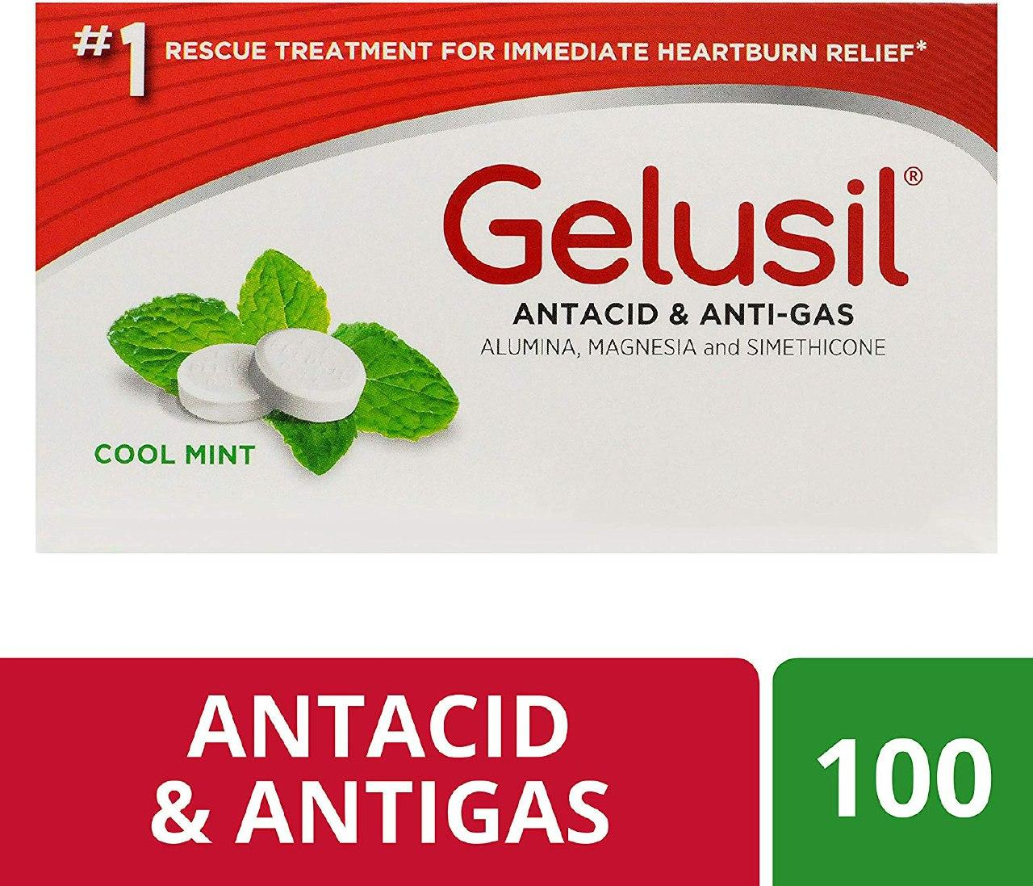
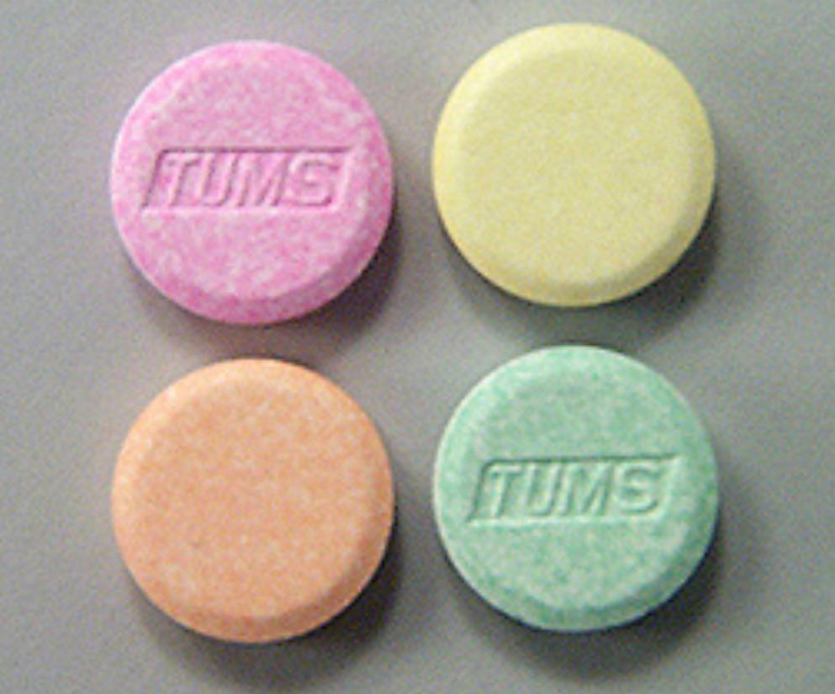
Antacids

Slide 2
Antacids:
Antacids are weak bases that react with gastric acid to form water & a salt to neutralize gastric acidity. Acts by raising intragastric PH.
They are useful in symptomatic treatment and have no effect on ulcer healing.
Antacids are divided into two groups:
a. Systemic antacids; as sodium bicarbonate
b. Non-systemic as magnesium salts, aluminium salts and calcium carbonate

Slide 3
Sodium bicarbonate:
Systemic antacids may cause systemic alkalosis. It has a rapid onset of action.
It increases the absorption of calcium from the GIT lead to hypercalcemia.
The excessive sodium may lead to hypernatremia and edema. HF?
When interact with gastric acid, sodium bicarbonate release CO2 & NaCl.

Slide 4
Magnesium hydroxide:
It is not absorbed systemically.
It has slow onset of action due to its insolubility.
It can cause diarrhea due to osmotic effect.
Aluminium hydroxide:
It is not absorbed systemically but can bind to phosphate in the GIT. So it is used to reduce phosphate absorption in case of hyperphosphatemia of renal failure.
It can cause constipation.

Slide 5
Calcium carbonate
It reacts with HCl to form CO2 & CaCl2, is also commonly used.
The absorption of phosphate is reduced in large and prolonged doses

Slide 6
Clinical uses of antacids:
1. Symptomatic treatment of peptic ulcer to relief pain but not healing
2.GERD & dyspepsia
Interactions with antacids:
Antacids can bind to drugs in the GIT and reduce their absorption such as iron, tetracycline

Slide 7
Misoprostol:
Is a prostaglandin analogue of PGE with an affinity for the gastric mucosa. It stimulates the secretion of mucus and bicarbonate, enhances cell proliferation, preserves the microcirculation, and stabilizes tissue lysosomes. Misoprostol is approved for protection against the ulcerogenic action of NSAIDs (not antagonizes NSAIDs).
Adverse effects:
1. Diarrhea and abdominal pain
2. Vaginal bleeding and dysmenorrhoea (abortion)

Slide 8
Mucosal protective agents
Also known as cytoprotective compounds.
They enhance mucosal protection mechanisms. So preventing mucosal injury, reducing inflammation, and healing of existing ulcers

Slide 9
Sucralfate
It is complex salt of sucrose sulphate and aluminium hydroxide
At low PH of the stomach sucralfate form a complex gels with damaged mucosa in ulcer base. This protecting the ulcer from pepsin & acid, allowing the ulcer to heal.
It is a mucosal protective (cytoprotective) agent has an equal efficacy to H2-antagonists. Its use is limited due to the multiple daily dosing & drugs interactions

Slide 10
Adverse effects:
It may cause constipation.
The drug is effective only in acid medium and therefore should not be given in combination with antacids.
Sucralfate can reduce the intestinal absorption of ciprofloxacin, theophylline.
Aluminium may accumulate in patients with renal failure.

Slide 11
Bismuth Chelate
It is a cytoprotective agent, acts by chelating with protein in the ulcer base to form a coating in the ulcer base, protecting ulcer from acid, pepsin and bile.
In addition it has a valuable action against Helicobacter pylori.
Has similar efficacy to cimetidine but in addition it causes less chances of recurrence due to bacterial eradication

Slide 12
Adverse effects
Liquid dosage form causes dark discoloration of the tongue and mouth.
There is little systemic absorption, but bismuth may accumulate in patients with renal failure.

Slide 13
Anticholinergic drugs
Pirenzepine, Probantheline, Clidinium bromide
These agents reduce the volume of gastric acid secretion without affecting the PH. They produce symptomatic relief in peptic ulceration, but they do not enhance ulcer healing.
Pirenzepine is water soluble and does not penetrate the CNS and has no central side effects. It also selective to muscarinic (M1) receptors in the gastric mucosa
All the anticholinergics have atropine like adverse effects.

Slide 14
NSAIDs and Peptic ulcers
Large number of patients taking NSAIDs aspirin, diclofenac sodium, and indemetacin.
Gastric erosion developed in about 80% of these patients and about 1-5% developed gastric or duodenal ulcer.
These drugs inhibits cyclooxygenase enzyme in its both types (COX1 and COX2). COX1 is important for the development of gastric mucosa, while COX2 mediates inflammatory reactions.

Slide 15
Inhibition of COX1 will lead to mucosal injury and cause peptic ulceration. The prostaglandin analogue misoprostol is useful in the prevention and treatment of such ulcer. Still PPIs are of choice.
The use of selective COX2 inhibitors as celecoxib is less likely to cause mucosal damage and are preferred in patients with peptic ulcer .

Slide 16
MCQ
Which one of the following drugs is used in treatment of peptic ulcer, has the correct mechanism of action?
Ranitidine: Mucosal protective agent
Omeprazole: Antihistamine
Sucralfate: Prostaglandin analogue
Misoprostol: proton pump inhibitor
Pirenzepine: Antimuscarinic

Slide 17
MCQ
All the following statements are true about antacids EXCEPT:
Sodium bicarbonate is a rapidly acting systemic antacid
Magnesium trisilicate is non-absorbable but can cause diarrhea
Aluminum hydroxide causes constipation
All antacids can reduce the absorption of iron and tetracycline
They usually lead to healing of peptic ulcer.

Slide 18
MCQ
Which of the following statements about antacids is correct:
Sodium bicarbonate can promote peptic ulcer healing
Magnesium salts cause constipation
Aluminium hydroxide reduce phosphate absorption .
Antacids enhance iron absorption
Sodium bicarbonate reduces absorption of calcium from the GIT

Slide 19
MCQ
The approved indication for misoprostol
a. Reflux esophagitis
b. Regional ileitis
c. Ulcerative colitis
d. Prevention of gastric ulceration in patients using large doses of NSAIDs
e. Pathologic hypersecretory conditions such as Zollinger-Ellison syndrome

Slide 20
MCQ
Misoprostol has a cytoprotective action on the gastrointestinal (GI) mucosa because it
a. Enhances secretion of mucus and bicarbonate ion
b. Neutralizes acid secretion
c. Antagonizes nonsteroidal anti-inflammatory drugs (NSAIDs)
d. Relieves ulcer symptoms
e. Coats the mucosa

